Slide 1
Fundamentals of Wireless Communication (D. Tse and P. Viswanath, Fundamentals of Wireless Communications.,) Detection and Estimation in Additive Gaussian Noise Manya Venissa Hanbat National University 29/09/2022

Slide 2
Contents
Gaussian Random Variable
Detection in Gaussian Noise
Estimation in Gaussian Noise

Slide 3
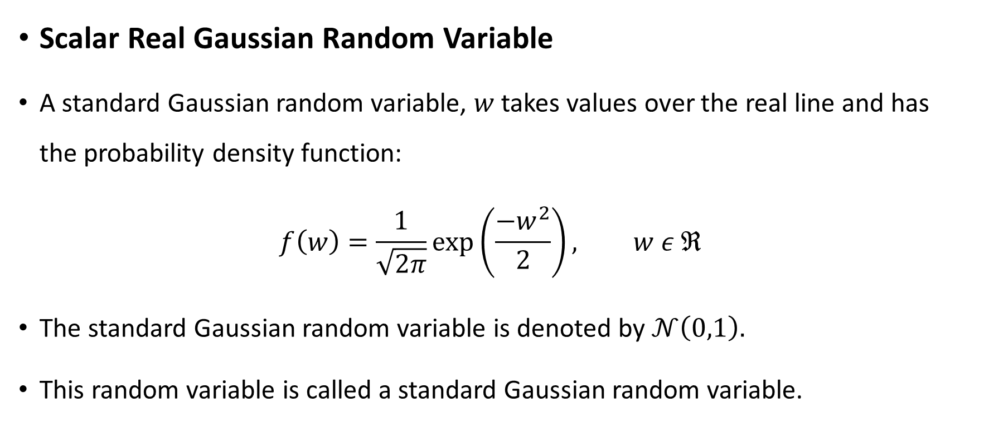
Gaussian Random Variable
Scalar Real Gaussian Random Variable
A standard Gaussian random variable, $w$ takes values over the real line and has the probability density function:
$$f\left(w\right)=\frac{1}{\sqrt{2π}}\exp\left(\frac{−w^{2}}{2}\right), w ε ℜ$$
The standard Gaussian random variable is denoted by $𝒩\left(0,1\right).$
This random variable is called a standard Gaussian random variable.

Slide 4
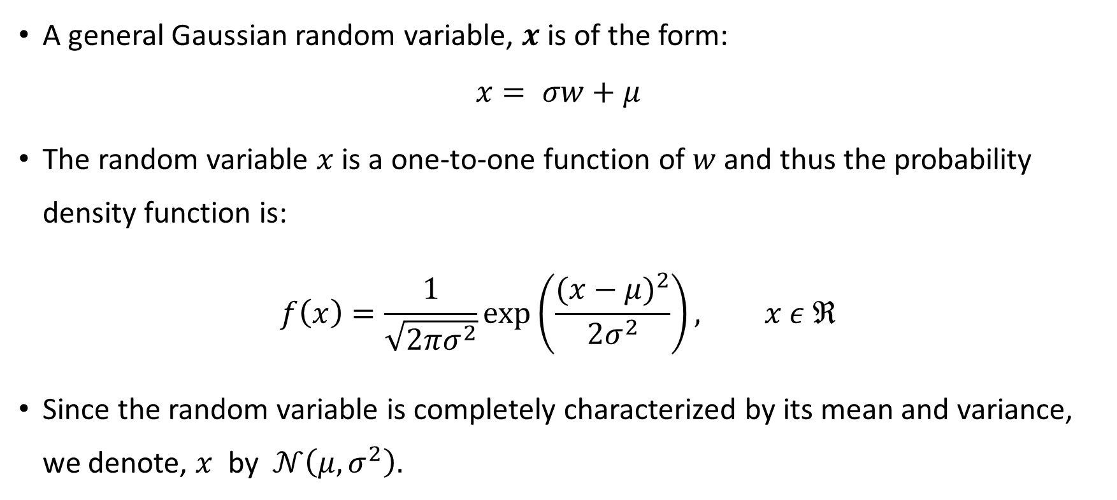
Gaussian Random Variable
A general Gaussian random variable, $x$ is of the form:
$$x= σw+μ$$
The random variable $x$ is a one-to-one function of $w$ and thus the probability density function is:
$$f\left(x\right)=\frac{1}{\sqrt{2πσ^{2}}}\exp\left(\frac{(x−{μ)}^{2}}{2σ^{2}}\right), x ε ℜ$$
Since the random variable is completely characterized by its mean and variance, we denote, $x$ by $𝒩\left(μ,σ^{2}\right).$

Slide 5
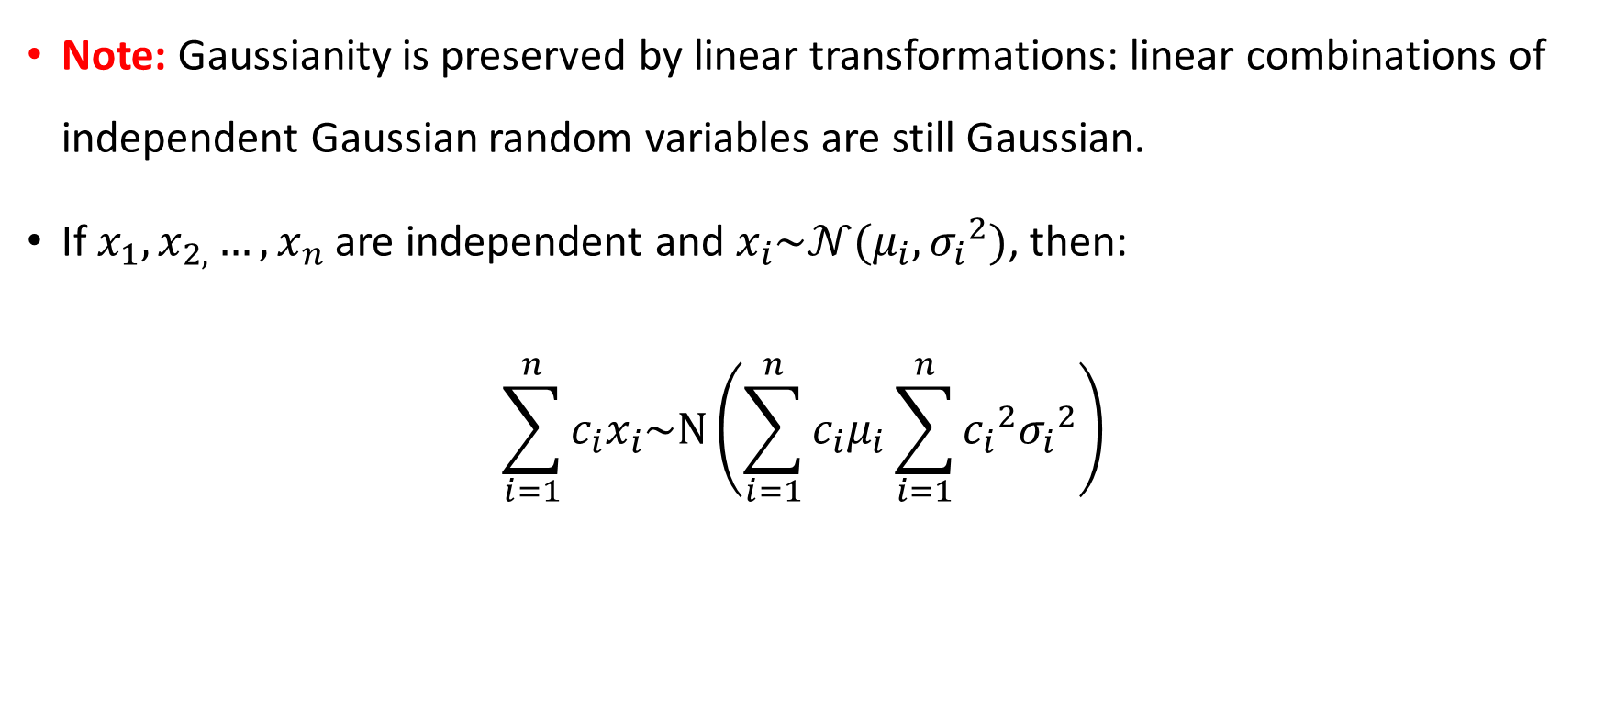
Gaussian Random Variable
Note: Gaussianity is preserved by linear transformations: linear combinations of independent Gaussian random variables are still Gaussian.
If $x_{1},x_{2,}…,x_{n}$ are independent and $x_{i}\sim 𝒩(μ_{i},{σ_{i}}^{2})$, then:
$$\sum_{i=1}^{n}{c_{i}x_{i}\sim Ν\left(\sum_{i=1}^{n}{c_{i}μ_{i}}\sum_{i=1}^{n}{{c_{i}}^{2}{σ_{i}}^{2}}\right)}$$

Slide 6
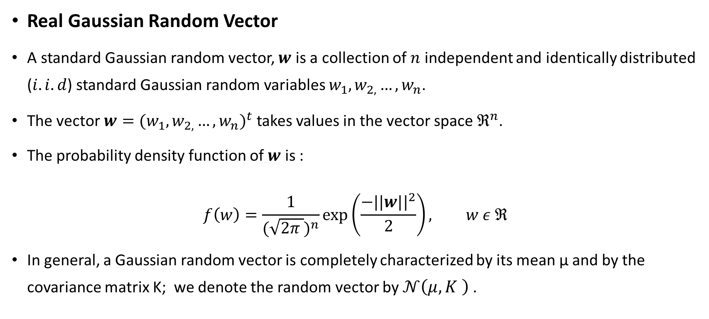
Gaussian Random Variable
Real Gaussian Random Vector
A standard Gaussian random vector, $w$ is a collection of $n$ independent and identically distributed ($i.i.d$) standard Gaussian random variables $w_{1},w_{2,}…,w_{n}$.
The vector $w=({w_{1},w_{2,}…,w_{n})}^{t}$ takes values in the vector space $ℜ^{n}$.
The probability density function of $w$ is :
$$f\left(w\right)=\frac{1}{{(\sqrt{2π })}^{n}}\exp\left(\frac{−{||w||}^{2}}{2}\right), w ε ℜ$$
In general, a Gaussian random vector is completely characterized by its mean µ and by the covariance matrix K; we denote the random vector by $𝒩\left(μ,K \right)$.

Slide 7
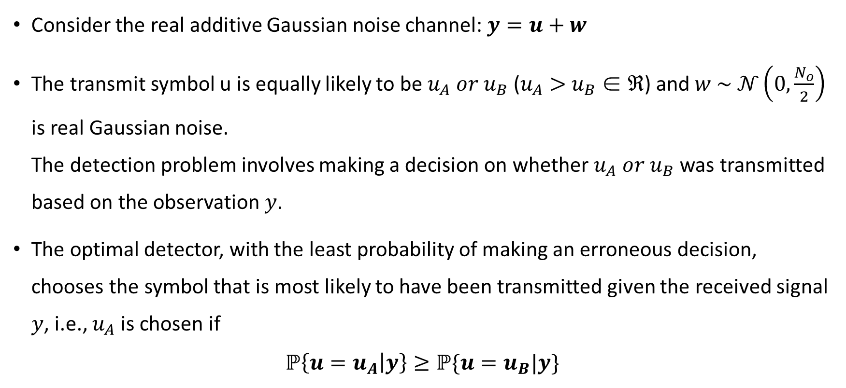
Detection in Gaussian Noise
Consider the real additive Gaussian noise channel: $y=u+w$
The transmit symbol u is equally likely to be $u_{A} or$ $u_{B}$($u_{A}>$ $u_{B}$∈ $ℜ$) and $w \sim 𝒩\left(0,\frac{N_{o}}{2}\right)$ is real Gaussian noise. The detection problem involves making a decision on whether $u_{A} or$ $u_{B}$was transmitted based on the observation $y$.
The optimal detector, with the least probability of making an erroneous decision, chooses the symbol that is most likely to have been transmitted given the received signal $y$, i.e., $u_{A}$is chosen if
$$ℙ\left\{u=u_{A} | y\right\}≥ℙ\{u=u_{B}|y\}$$

Slide 8
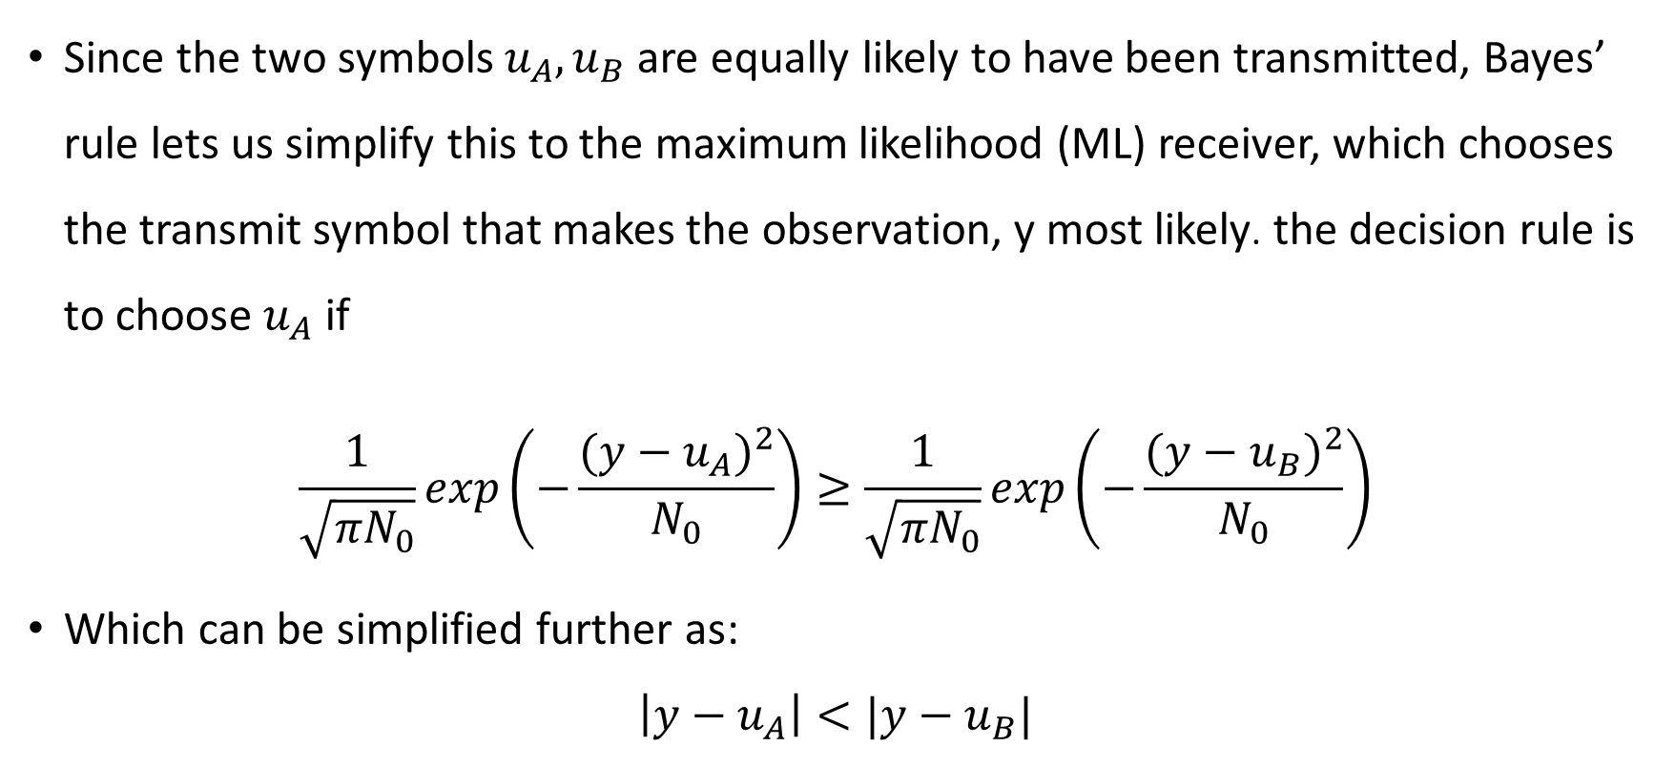
Detection in Gaussian Noise
Since the two symbols $u_{A},u_{B}$are equally likely to have been transmitted, Bayes’ rule lets us simplify this to the maximum likelihood (ML) receiver, which chooses the transmit symbol that makes the observation, y most likely. the decision rule is to choose $u_{A}$ if
$$\frac{1}{\sqrt{{πN}_{0}}}exp\left(−\frac{{(y−u_{A})}^{2}}{N_{0}}\right)≥\frac{1}{\sqrt{{πN}_{0}}}exp\left(−\frac{({y−u_{B})}^{2}}{N_{0}}\right)$$
Which can be simplified further as:
$$\left|y−u_{A}\right|<|y−u_{B}|$$

Slide 9
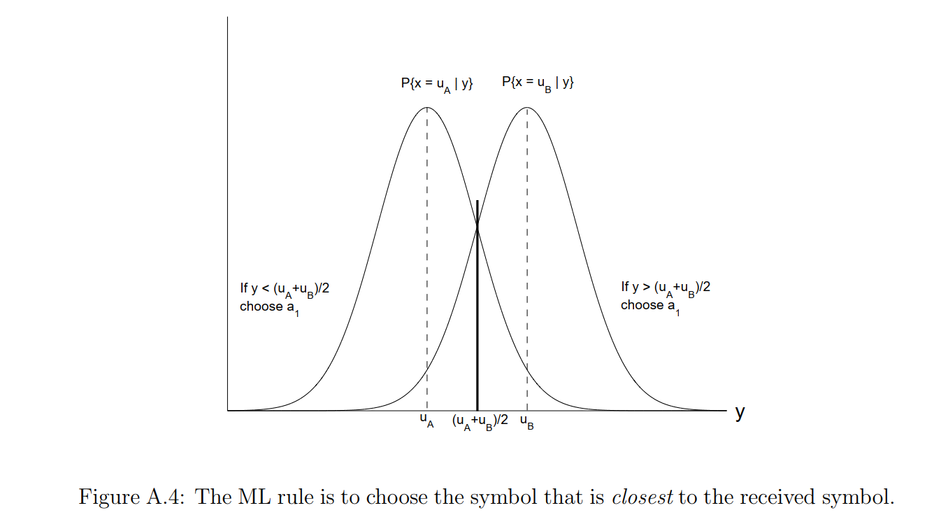
Detection in Gaussian Noise

Slide 10
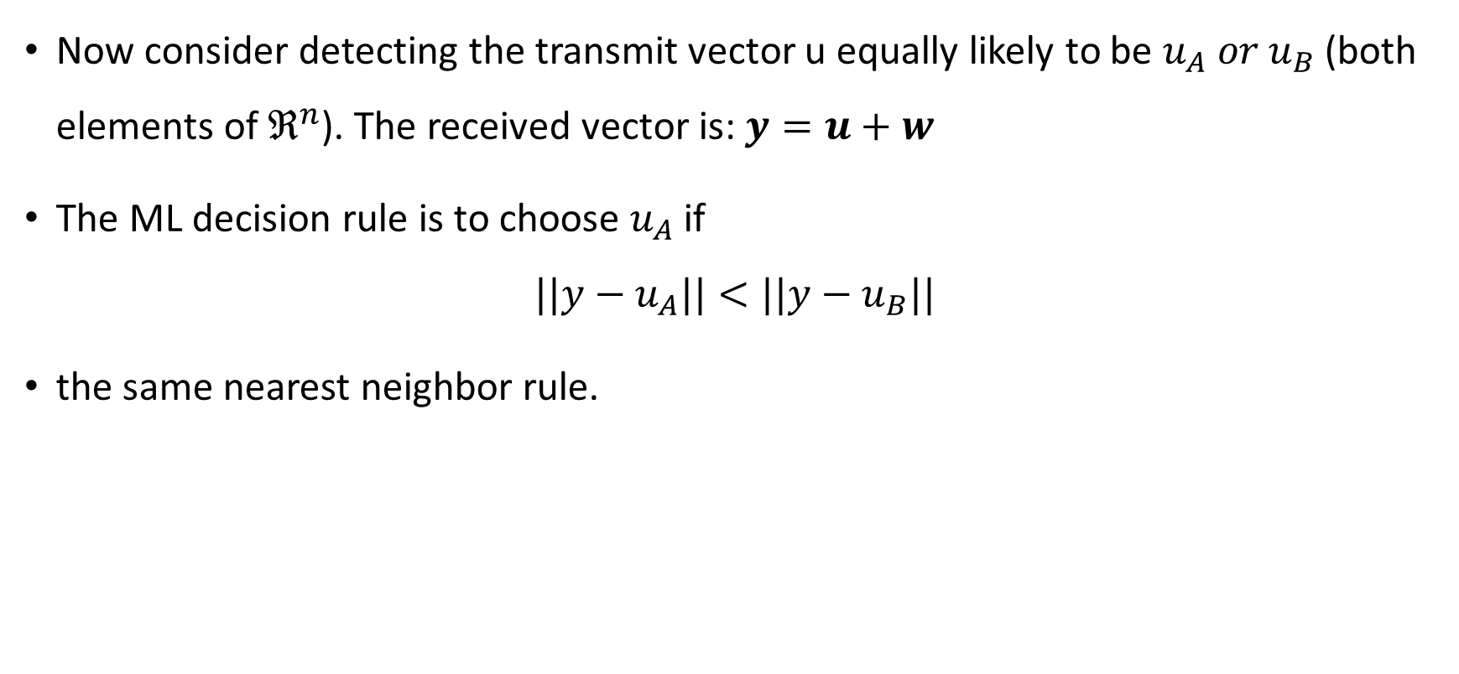
Detection in Vector Space
Now consider detecting the transmit vector u equally likely to be $u_{A} or$ $u_{B}$(both elements of $ℜ^{n}$). The received vector is: $y=u+w$
The ML decision rule is to choose $u_{A}$if
$$||y−u_{A}||<||y−u_{B}||$$
the same nearest neighbor rule.

Slide 11
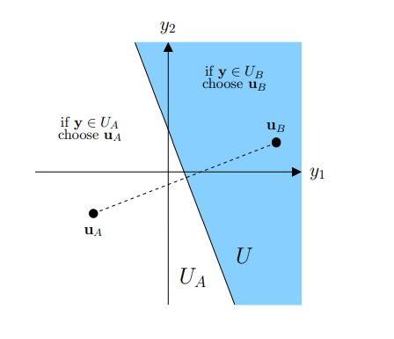
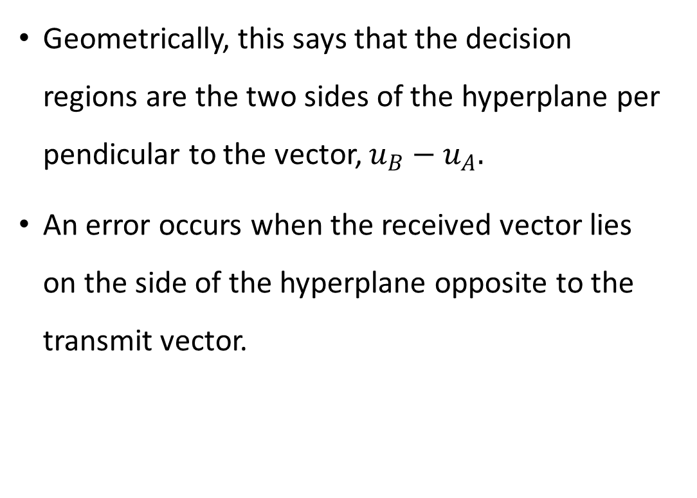
Detection in a Vector Space
Geometrically, this says that the decision regions are the two sides of the hyperplane perpendicular to the vector, $u_{B}−$ $u_{A}.$
An error occurs when the received vector lies on the side of the hyperplane opposite to the transmit vector.

Slide 12
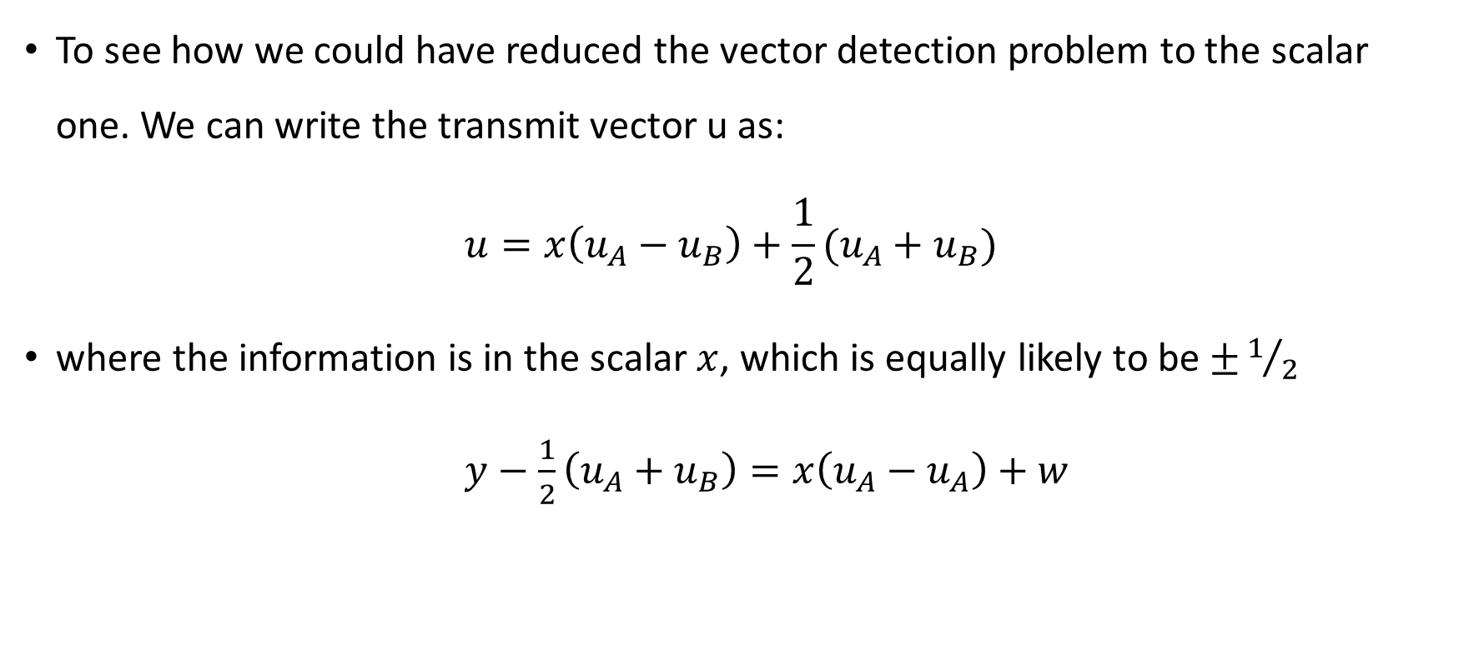
Alternative View
To see how we could have reduced the vector detection problem to the scalar one. We can write the transmit vector u as:
$$u=x\left(u_{A}−u_{B}\right)+\frac{1}{2}(u_{A}+u_{B})$$
where the information is in the scalar $x$, which is equally likely to be $±1/2$
$y−\frac{1}{2}\left(u_{A}+u_{B}\right)=x\left(u_{A}−u_{A}\right)+w$

Slide 13
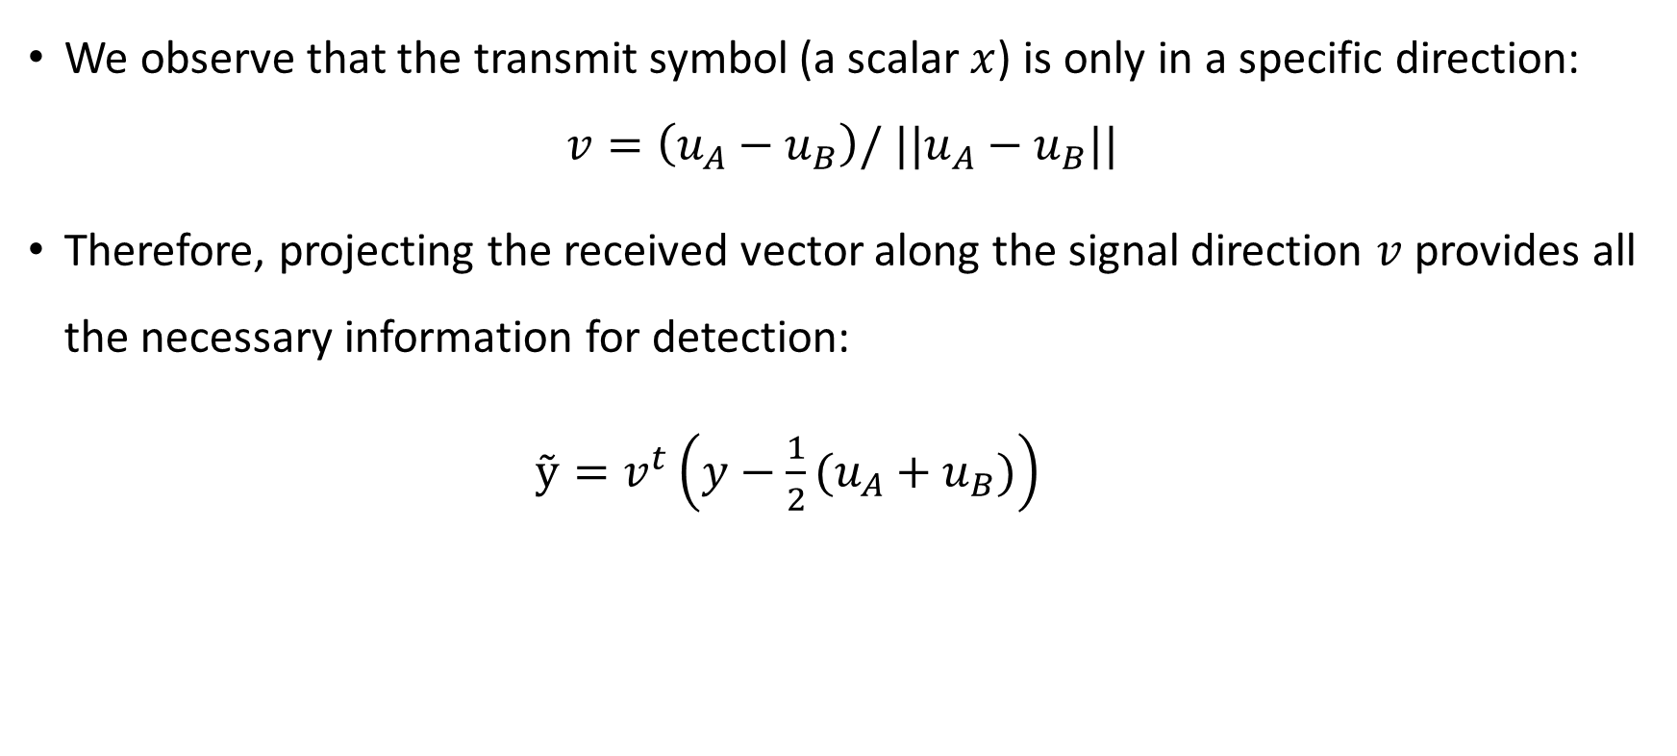
Alternative View
We observe that the transmit symbol (a scalar $x$) is only in a specific direction:
$$v=\left(u_{A}−u_{B}\right)/ {||u}_{A}−u_{B}||$$
Therefore, projecting the received vector along the signal direction $v$ provides all the necessary information for detection:
$ỹ=v^{t}\left(y−\frac{1}{2}(u_{A}+u_{B})\right)$

Slide 14
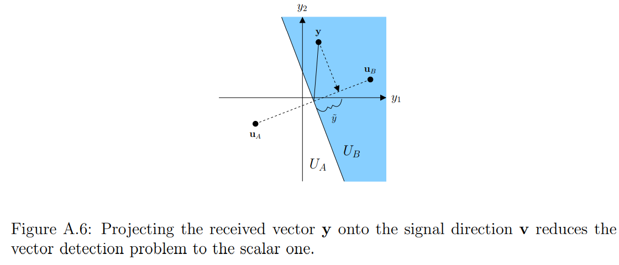
Alternative View

Slide 15
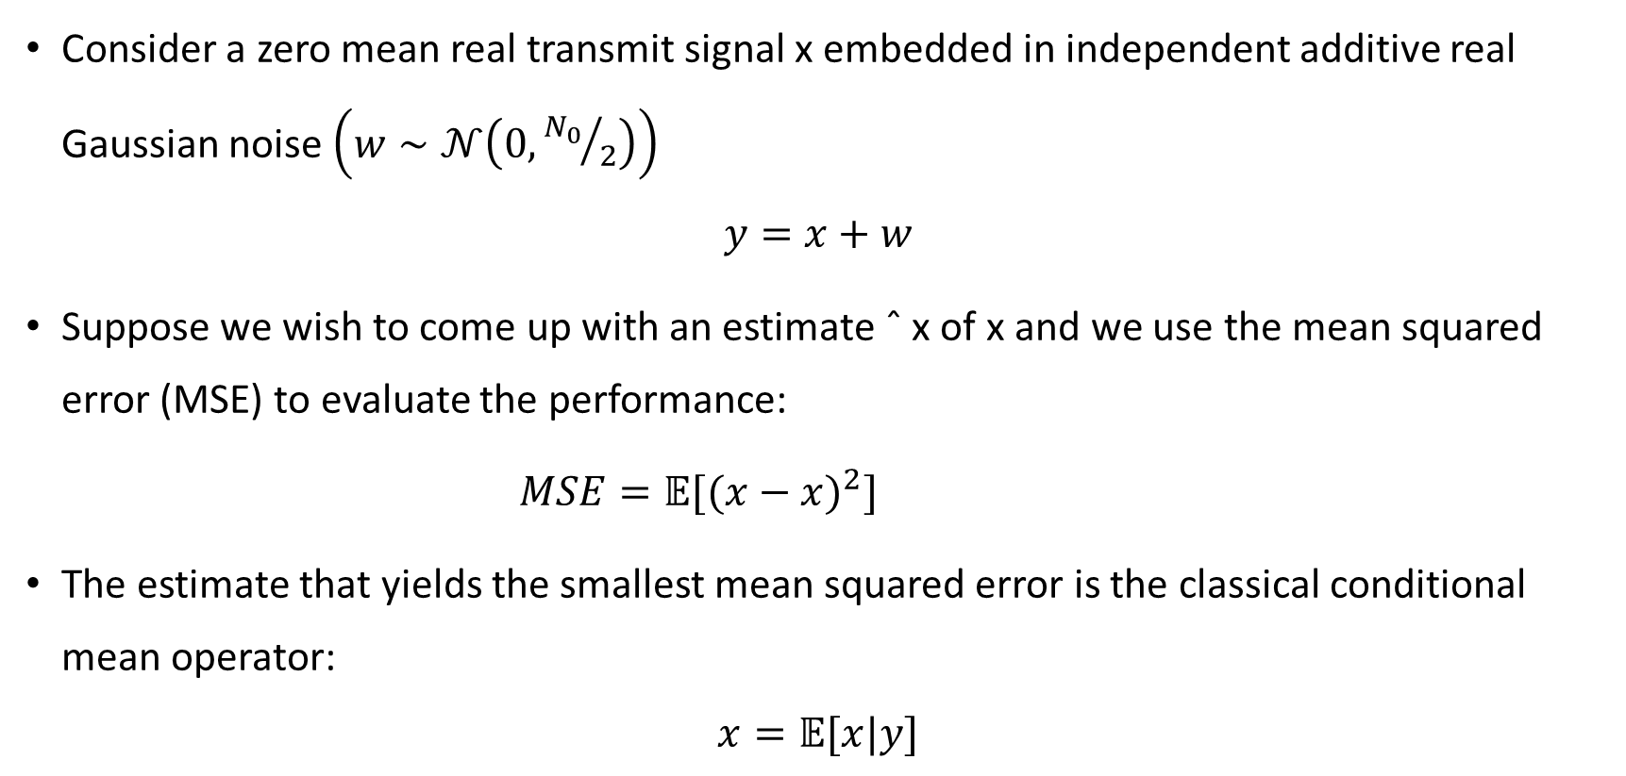
Estimation in Gaussian Noise
Consider a zero mean real transmit signal x embedded in independent additive real Gaussian noise $\left(w∼𝒩\left(0,{N_{0}}/2\right)\right)$
$$y=x+w$$
Suppose we wish to come up with an estimate ˆ x of x and we use the mean squared error (MSE) to evaluate the performance:
$MSE=𝔼[{(x−x)}^{2}]$
The estimate that yields the smallest mean squared error is the classical conditional mean operator:
$$x=𝔼[x|y]$$

Slide 16
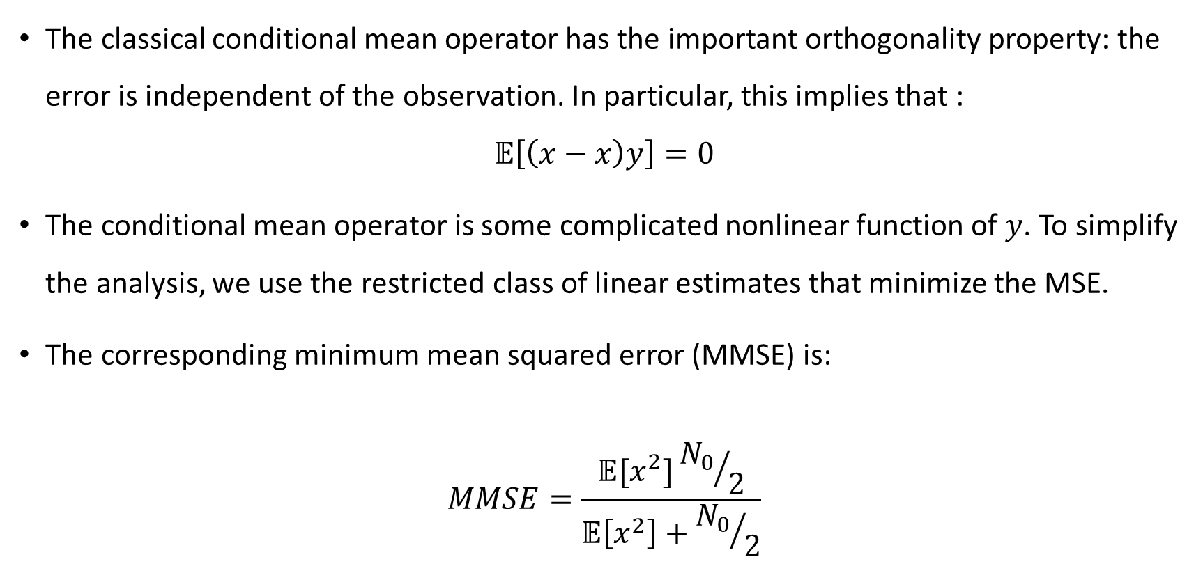
Estimation in Gaussian Noise
The classical conditional mean operator has the important orthogonality property: the error is independent of the observation. In particular, this implies that :
$$𝔼\left[\left(x−x\right)y\right]=0$$
The conditional mean operator is some complicated nonlinear function of $y$. To simplify the analysis, we use the restricted class of linear estimates that minimize the MSE.
The corresponding minimum mean squared error (MMSE) is:
$$MMSE=\frac{𝔼[x^{2}]{N_{0}}/2}{𝔼\left[x^{2}\right]+{N_{0}}/2}$$

Slide 17

Any Questions?
Email: manyavenissa@gmail.com

